Slide 1


MEDIBAND (A MEDICAL SMARTBAND)
By :
SURYA NARAYANAN CS
RITHVIKAILAS G
RUBIGA SA
SHURTHIKA R
MENTOR
MR.ANAND, ASSISTANT PROFESSOR,
DEPARTMENT OF ECE

Slide 2
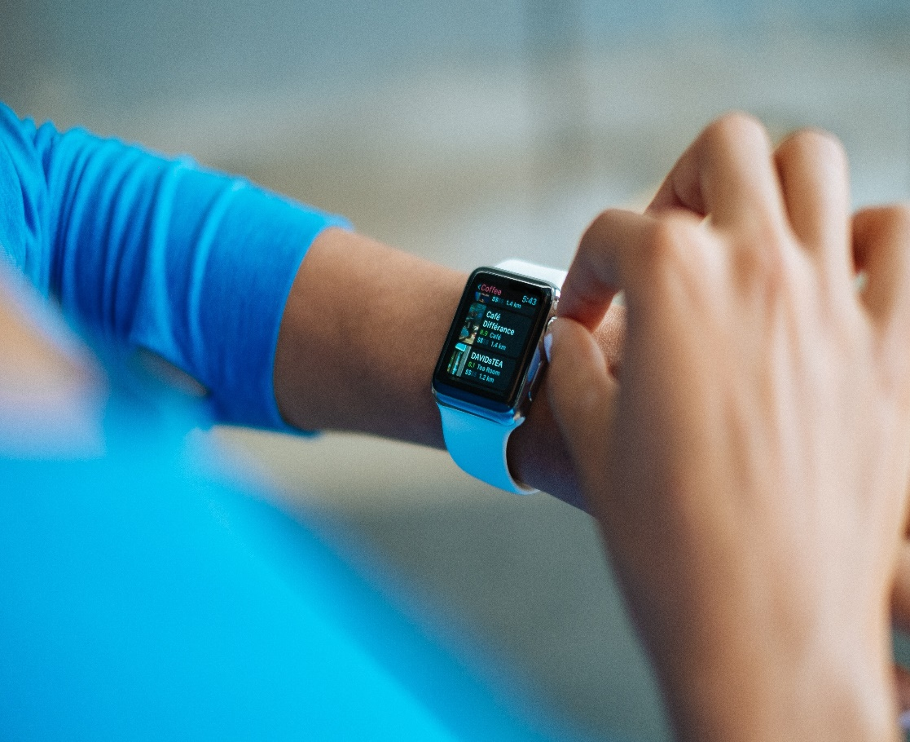

PROBLEM STATEMENT
* Fall detection is a major challenge in the public healthcare domain, especially for the babies and elderly
* Timely and reliable surveillance is necessary to mitigate the negative effects of falls.
* To decline of their physical fitness

Slide 3
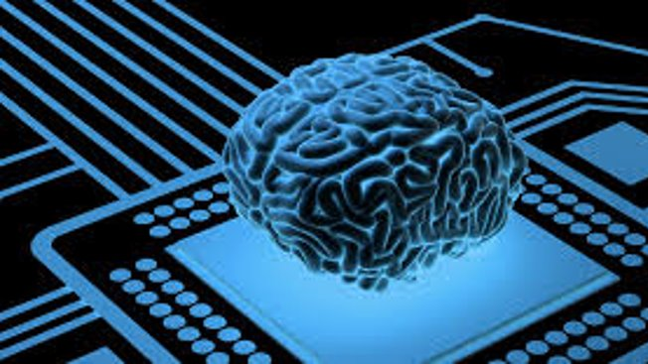
OBJECTIVES
Fall detection is a major challenge in the public healthcare domain, especially for the babies and elderly as the decline of their physical fitness, and timely and reliable surveillance is necessary to mitigate the negative effects of falls.
Our system monitors the movements of human body, recognizes a fall from normal daily activities by an effective quaternion algorithm, and automatically sends request for help to the caregivers with the patient’s location

Slide 4
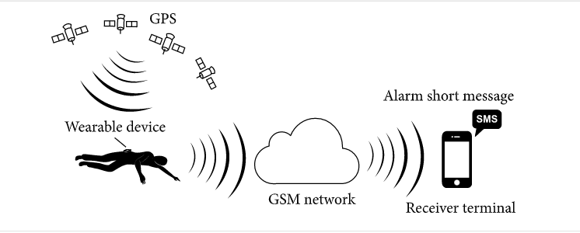
SYSTEM DESIGN :

Slide 5

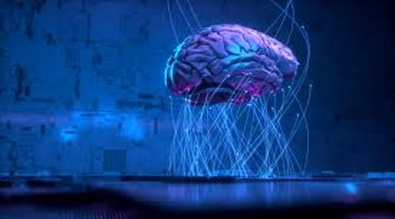
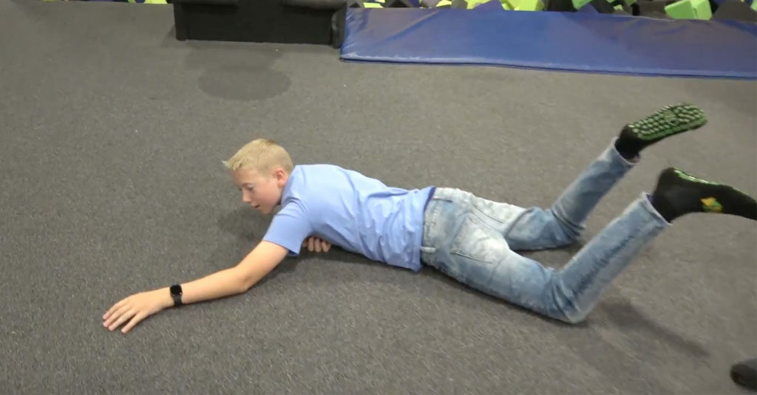
IMPLEMENTATION:
A wearable device is placed on human’s wrist. The system can detect the elderly’s falling by acceleration analysis. Then it will get the elderly’s geographic position and send fall alarm short message to caregivers. So the elderly who has fallen can get timely help to minimize the negative influence.
Each hardware component of the wearable device is working under low voltage and the detection algorithm does not need complex calculation resource, so the power consumption of the whole device is quite low. A 1200 mAh, 3.7 V polymer lithium battery is quite enough to provide the need of the wearable device for a couple of days.

Slide 6

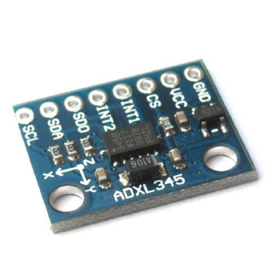
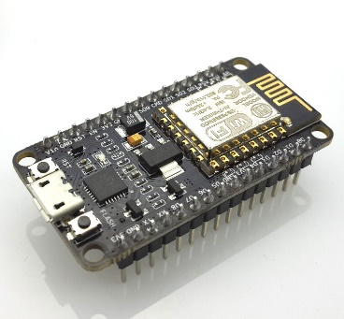
Components:
Accelerometer:
The accelerometer works on the movement or the vibration of the body. It can even sense the vibration in micro-scale. It senses the vibration and converts the vibration into the piezoelectric effect. (Ability of materials to generate electric charge.)
Node MCU:
Node MCU is a low cost open source which initially included firmware which runs on ESP8266 wifi SoC and hardware which was based on ESP12 module.
Twilio API:
An Alert resource instance represents a single log entry for an error or warning encountered when Twilio makes a webhook request to your server, or when your application makes a request to the REST API.

Slide 7
WORKING OF THE BAND:
Records acceleration
Fall detection algorithm
Falling!
No
Yes
Get positive and send a call
Remind the victim
No
Withdraw alarm?
Yes
Inform caregivers through call

Slide 8
Features:
Outcomes:
Easy to monitor the disabled people.
Suitable to monitor babies under 4 years.
Size of the device will compact to all and easy to wear.
Accident prior Detector.
Women safety protector feature.
Heart pulse Detector.

Slide 9


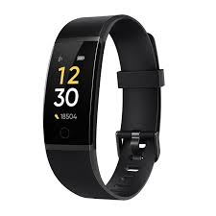

Slide 10
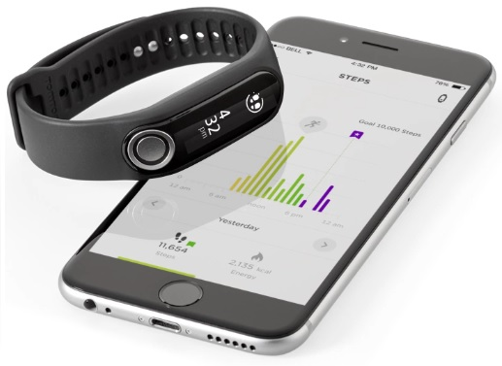

CONCLUSION:
This project developed a fall detection system based on a single triaxial accelerometer based wearable device. There is no special requirement of the device’s mounting orientation because the algorithm does not claim the axes of accelerometer to be fixed strictly.
The system has low power consumed hardware design and highly efficient algorithm which could extend the service time of the wearable device. Both the hardware and software designs are suitable for wearable and outdoor application.

